Slide 1
Trade-off Between Convergence and Final Performance: Backward Q-Learning Based SARSA (BQSA)
Aidar Shakerimov and Dmitriy Li
Nazarbayev University, CSCI 399 Final Presentation
Reproduction of the paper “Backward Q-learning: The combination of SARSA algorithm and Q-learning (Wang, Li and Lin, 2013)

Slide 2
Outline
Motivation of the research
Description of the proposed method
Reproduction description
Discussion
Appendix:
Typo in pseudocode
Detailed description of Cliff Walking environment
Detailed pseudocode of the learning agent
Detailed pseudocode of the testing phase
Comments on parameters
Reverse update

Slide 3

1. Motivation of the Research
Policy - the core of reinforcement learning agent, the way of behaving at a given situation. (Sutton and Barto, 2015)
How to update a policy?
Two ways to update policy immediately (Temporal Difference):
Q-learning vs SARSA
taking into account the maximum output of next step vs taking into account the current policy
(Sutton and Barto, 2015)

Slide 4
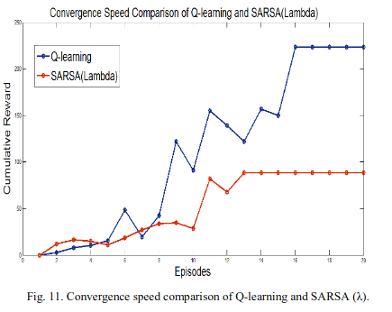
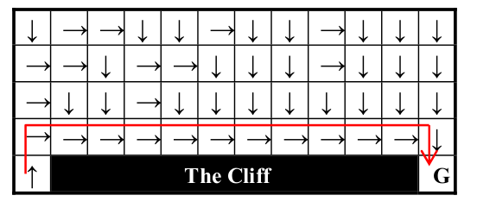
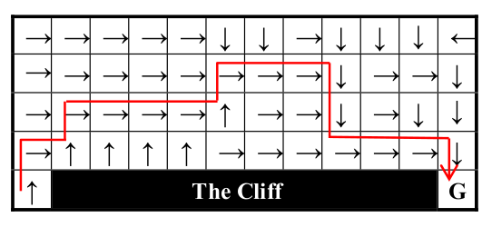
1. Motivation of the Research
Q-learning vs SARSA
Resulting trade-off:
more profitable behaviour, without care of risks vs more stable convergence but sometimes suboptimal
Examples with optimal way finding problem:
From Habib et al, 2016:
An optimal path finding problem
Y-axis - cumulative reward (performance)
X-axis - episodes (convergence)
Q-learning - blue
SARSA - red
From Wang, Li and Lin, 2013:
Cliff-Walking (see details in appendix B)
Q-learning (upper) finds the optimal path,
SARSA (lower) finds a safer path

Slide 5
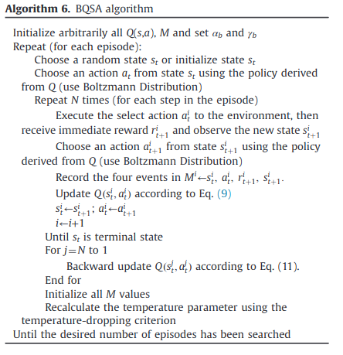
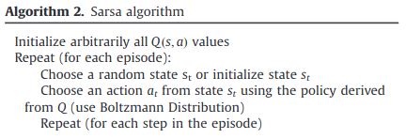
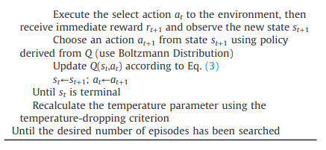
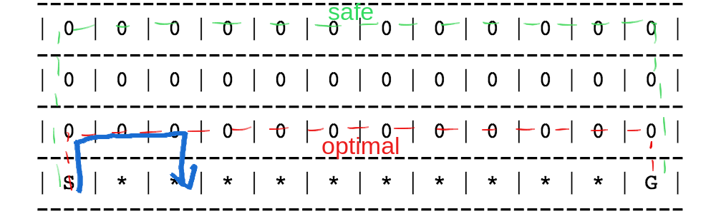
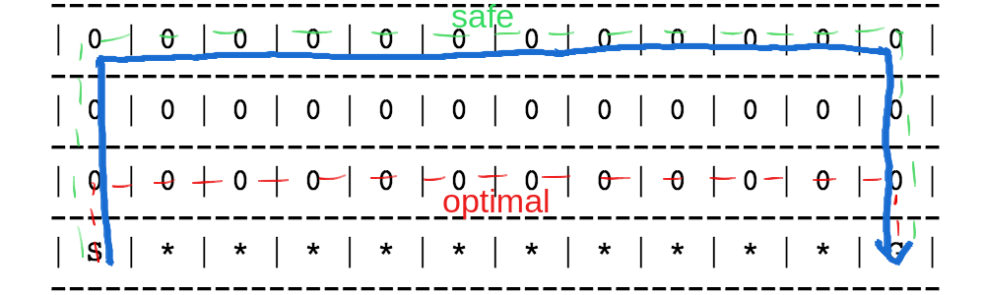
2. Description of the proposed method
Fig. SARSA pseudocode
Fig. BQSA pseudocode
(3)*
*explanation can be found in appendix A
In BQSA, SARSA is used as a basement in order to find a policy to converge faster. During an episode update function takes into account the action selection policy:
a) following an optimal path SARSA agent discovers falling from the cliff;
b) because of exploration strategy, SARSA agent will tend to choose safer path;
c) after some time the agent will converge to the safer path.
Safe convergence of SARSA

Slide 6
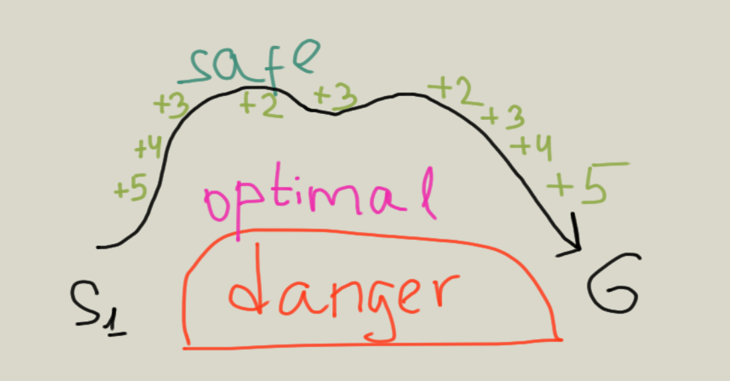
2. Description of the proposed method
Fig. BQSA pseudocode
At the end of each episode BQSA looks to all visited steps from Q-learning perspective:
It is backward updated because values of newer steps (St+1) will be used in updating older steps (St)
Fig 4. Backward Q-learning evaluates steps closer to the optimal higher than those which are farther:
Q-learning perspective is greedy:
We use different learning rate* in order to vary the impact of backward update:
*discount factor is kept the same in the paper

Slide 7
3. Reproduction description: learning agent (BQSA)
See detailed pseudocode in appendix C
Initialize Q-table: 2D array (# of states, # of actions)
Specify goal state and cliff states
Initialize memory buffer for backward update: list of 4-tuples
Set parameters (learning rates and discount factors) according to the paper (see appendix E)
Repeat until the end of learning phase (300 goals to reach):
Initialize fixed starting location (x, y) and convert it to the integer state = 12x + y
Select an action by epsilon-greedy* policy
Repeat until the goal state or a cliff state is reached:
Change location of the agent according to the action and convert it to the integer next_state
Obtain: reward = -10 if next_state = a cliff state
Or reward = 10, goals =+ 1 if next_state = the goal state
Or else reward = -1
Save tuple = (state, action, reward, next_state) into the memory buffer
Select next_action by epsilon-greedy policy
Q-table [state, action] = Q-table [state, action] + alpha * (reward + gamma * Q-table [next_state, next_action] - Q-table [state, action])*
Rewrite state = next_state and action = next_action
Repeat backwards until memory is empty:
Pop a tuple (state, action, reward, next-state) from the memory buffer
Q-table [state, action] = Q-table [state, action] + alpha * (reward + gamma * max (Q-table [next_state, : ]) - Q-table [state, action])
Reinitialize memory buffer
Decay the exploration rate for epsilon-greedy policy
At each episode the agent starts from the same location
The agent performs a transition and updates its policy towards it according to the SARSA principle. All elements of a transition are stored.
The agent re-updates the policy towards all transitions that took place in the episode
* we use the epsilon-greedy action selection policy due to the absence of required data on usage of the Boltzmann policy in the paper

Slide 8
4. Discussion
A difficulty:
Could not replicate the experiment precisely due to the absence of available implementation from authors.
We reproduced most of parts of the experiment ourselves based on our understanding of the paper.
How will we verify our reproduction?
We consider three important points to be achieved:
Verify the authenticity by careful description of each implementational decision with reference to the paper (see appendix C).

Slide 9
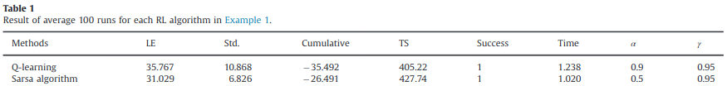
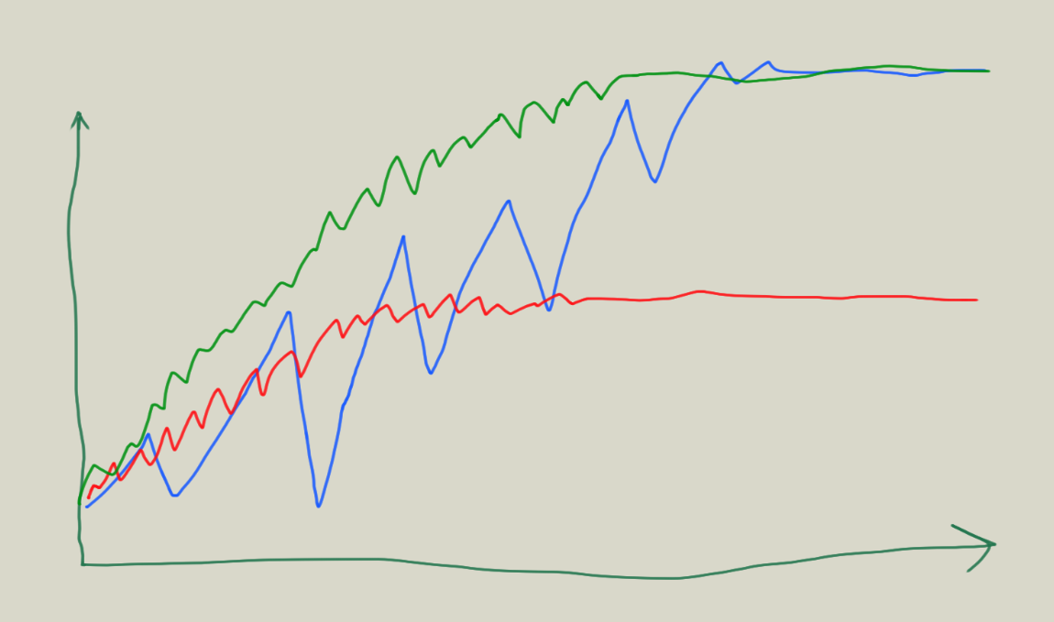
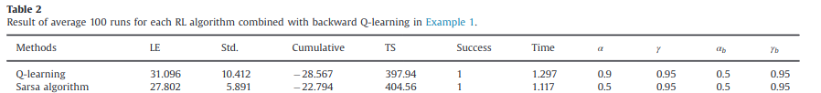
4. Discussion
How will we verify our reproduction?
2. Capture the on-line performance and convergence during the learning: record cumulative rewards per episode, fluctuations of cumulative reward and total time of learning phase (see implementation details in appendix C).
Compare the results with the expected behaviour according to the paper:
Cumulative reward
Average length of an episode
Average fluctuations of rewards
Average cumulative reward per episode
Average time of the learning (300 goals)
Episodes
According to the paper, BQSA should provide less fluctuations, better average cumulative rewards and give a medium convergence speed between SARSA and Q-learning

Slide 10
4. Discussion
How do we verify our reproduction?
3. Test the final quality of generated policy by running a greedy agent. Evaluate the optimality of the performed actions (BQSA should provide optimality) in terms of total performed steps:
Use the same Q-table obtained after the learning phase
Repeat until the end of testing phase (49 episodes):
Obtain new starting location (x, y) and convert it to the integer state = 12x + y
Repeat until the goal state or a cliff state is reached:
Select an action by greedy policy
Change the location of the agent according to the action and convert it to the integer next_state
Obtain: goals =+ 1 if next_state = the goal state
Rewrite state = next_state and action = next_action
Check whether all 49 episodes were successful and total steps were minimal
Run a greedy exploiting policy in order to get rid of learning at this phase
See detailed pseudocode in appendix D

Slide 11
4. Discussion
Senior project topic:
Study of the impacts of BQSA components towards convergence and final performance in environments with varying granularity of the state space.
Objectives of the project:
Evaluate speed of convergence and final performance of Q-learning and SARSA
Summarize the principle of combining SARSA and Q-learning by Wang, Li and Lin, 2013 in terms of convergence and final performance.
Introduce/propose a middle-step-algorithms between SARSA/Q-learning and BQSA using the idea of reversed policy update from Vu and Tran, 2020 (see Appendix F).
Evaluate convergence and final quality of the policies generated by different levels of algorithms in environment with different granularity of state space.
Summarize the impacts of each component of BQSA in terms of convergence and final performance.
Deliverables of the project:
An illustration of difference between SARSA, Q-learning and BQSA in terms of convergence and final performance.
A proposed middle-step methods between Q-learning/SARSA and BQSA using idea of reversed policy update.
An implementation of Python code of Q-learning, SARSA, BQSA and middle-step algorithms in different environments using Gym library.
[Demo] Visualization of performances of the agents in environments with varying granularity of state spaces using the Matplotlib libraries.

Slide 12
5. Summary
In general, stability of the progress of the research depended on the clarity of the basic knowledges:
Understanding of the principles of Q-learning and SARSA was crucial for starting research.
Balancing between relevance and reproducibility is important:
Most of new methods in RL introduce integration of deep learning which is hard to understand and reproduce on the UG level. On the other hand, simpler methods may be older and have less space for contribution.
A division of the labour in research may lead to considerable gaps in each team-mate’s understanding of the subject:
It is important to push each other’s understanding periodically.

Slide 13
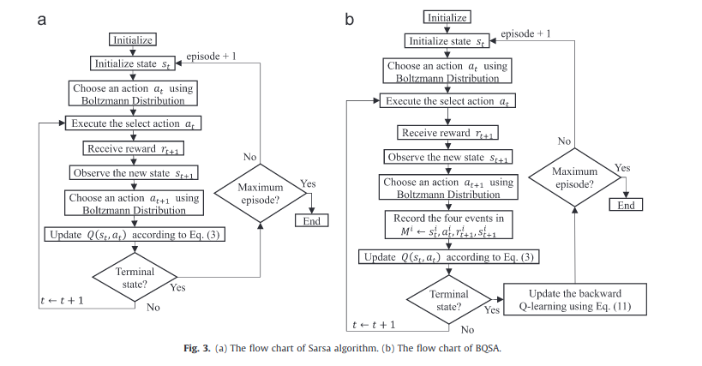
Appendix A: Typo in pseudocode
(Wang, Li and Lin, 2013: 2188 page)
From SARSA:
(Wang, Li and Lin, 2013: 2186 page)
From Q-Learning:
(Wang, Li and Lin, 2013: 2188 page)
(3)
Wrong equation is used. BQSA is SARSA based algorithm, but Q-Learning update rule is used (Eq. 9). Equation 3 should be used instead:
There is correct usage in the flow chart comparing SARSA and BQSA.
Ding et. al 2019 uses BQSA with equation 3.

Slide 14
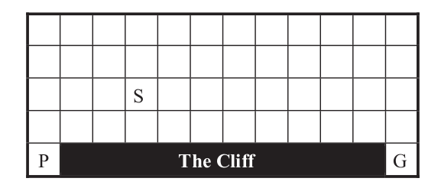
Appendix B: Detailed description of Cliff-Walking environment
12*5 states, 4 actions
Observation = (0<=x<12, 0<=y<5)
State - numeric representation of an observation [0..59]
Cliff states = [49..58]
Goal state = 59
Starting state - random (randomised for each run) state except the cliff
Learning phase - until goal state is reached 300 times
Testing phase - 48 runs, starting from each available starting state
Actions = [0..3] up-down-left-right
Reward = -1 for each step
Reward = -10 if state = cliff
Reward = 10 if state = goal
Evaluation Metrics:
Length of episode (LE) show on-line performance during learning phase
Total steps (TS) counted at each run of testing phase, show quality of actions (final performance)
Standard deviation of cumulative rewards (Std) and time of learning phase show speed of convergence

Slide 15
Appendix C
Choose an action selection policy: epsilon-greedy
Create a Q-table = 2D array (number of states, number of actions)
Specify parameters: alpha = 0.9, alpha_b = 0.5, gamma = 0.95, gamma_b = 0.95 # the parameters are chosen experimentally according to best outputs, read the explanation in appendix E
Specify epsilon (depending on your action selection policy)
Initialize memory = list( ) # list of 4-tuples for storing recordings of (state, action, reward, next_state) at each transition
Initialize the agent’s location randomly:
X_init = random_integer(0 .. 3); Y_init = random_integer(0 .. 11) or (X, Y) = (4, 0) # agent starts from random state except for the cliff and the goal state: (4, 1 .. 11)
Initialize an indicator of the end of the learning phase: goal_counter = 0 # ends when 300 goals are reached
Initialize cache for all length of episodes and cumulative rewards per episodes for the run: length_cache = list ( ), reward_cache = list ( ) # metrics for evaluation of the learning phase
Start a loop of episodes until goal_counter == 300 : # start the run
Initialize indicator of finished episode: episode_end = False # auxiliary boolean variable to end the episode
Initialize cumulative reward value: reward_cumulative = 0 # cumulative reward per episode
Initialize index for the memory list: index = 0 # auxiliary variable to keep the recording in the memory indexed, also counts length if each episode
Place the agent to the starting location:
X = X_init; Y = Y_init # initialize or return to the start position
state = 12*X + Y # give an integer state to the agent according to its location
Select an action according to the action selection policy:
action = epsilon-greedy (state, Q-table, epsilon)
Start a loop of steps until episode_end == True : # start an episode
Move the agent in accordance with the chosen action:
If action == 0 and X > 0: X = X - 1 # go up
Else if action == 1 and Y > 0: Y = Y -1 # go left
Else if action == 2 and Y < 11: Y = Y + 1 # go right
Else if action == 3 and X < 4: X = X + 1 # go down
Obtain next_state = 12*X + Y # obtain an integer value of a new state according to the new location
Obtain a reward :
If next_state == 59: reward = 10, episode_end = True, goal_counter =+ 1 # goal state reached
Else if next_state > 48 and next_state < 59: reward = -10, episode_end = True # agent falls from the cliff
Else reward = - 1 # agent performs one more step
Save 4 elements into memory: memory [ index] = tuple (state, action, reward, next_state)
Update Q-table according to SARSA principle: # see formula 3
Select the next action according to the action selection policy:
next_action = epsilon-greedy (next_state, Q-table, epsilon)
Q-table [state, action] = (1 - alpha) * Q-table [state, action] + alpha * (reward + gamma * Q-table [next_state, next_action])
Replace the state and the action with new values:
state = next_state
action = next_action
Accumulate reward_cumulative =+ reward # increment the cumulative reward of the episode
Increment index =+ 1 # increment the length of the episode and index of a recording
Save the length and cumulative reward of the episode: length_cache.append (index), reward_cache.append (reward_cumulative) # save the results of the ended episode
Start a reverse loop of steps for backward Q-learning update until index == 0: # pop a recording from the memory and put 4 elements in the Q-learning formula
tuple (state, action, reward, next_state) = memory [index]
Update Q-table according to Q-learning principle: # see formula 11
Obtain maximum value of the next state: maximum_next = max (Q-table[next_state, next_action = 0] .. Q-table[next_state, next_action = 3])
Q-table [state, action] = (1 - alpha_b) * Q-table [state, action] + alpha_b * (reward + gamma_b * maximum_next)
Decrement index =- 1
Reinitialize memory = list ( )
decay epsilon (depending on your action selection policy)
Return average (length_cache), average (reward_cache), # average length and cumulative reward of an episode display on-line performance of an agent
std (reward_cache) # standard deviation of the rewards per episode displays fluctuations of performance and reversely illustrates a closeness to the convergence
and sum (length_cache) # total length of learning phase illustrates a speed of convergence
Epsilon-greedy (state, Q-table, epsilon):
Choose a random number e = random[0 .. 1)
If (e < epsilon):
action = random integer in [0 .. 3]
Else:
action = argmax (Q-table [state, :])
Return action
Learning agent (BQSA)

Slide 16
Appendix D
Choose the same action selection policy as in learning phase
Use the Q-table obtained in the learning phase
Initialize total steps counter: total_steps = 0 # metrics for evaluation of the testing phase
Initialize success rate of testing phase: success = 0 # test is successful if the agent reaches the goal from each available starting state
Initialize goals counter: goal_counter = 0 # need to reach the goal 49 times (from each available state)
Start a loop - for state in 49 available states:
Place the agent according to the specified state: # decode the location given integer state
X = int (state / 12)
Y = state - 12 * X
Initialize an indicator of finished episode: episode_end = False # an auxiliary variable to end an episode
Initialize a counter for steps in the episode: step_counter = 0 # an auxiliary variable to count steps
Start a loop of steps until episode_end == True
Select an action according to the greedy policy: # test the behaviour policy obtained in the learning phase
action = argmax (Q-table [state, : ])
Move the agent in accordance with the chosen action:
If action == 0 and X > 0: X = X - 1 # go up
Else if action == 1 and Y > 0: Y = Y -1 # go left
Else if action == 2 and Y < 11: Y = Y + 1 # go right
Else if action == 3 and X < 4: X = X + 1 # go down
Obtain next_state = 12*X + Y
Check for the end of the episode :
If next_state > 48: episode_end = True # agent falls from the cliff
If next_state == 59: Increment goal_counter =+ 1, episode_end = True # reaches the goal state
Replace the state with new value:
state = next_state
Increment total_steps =+ 1
Check the success of the testing phase: success = goal_counter / 49 # evaluate ratio of successful episodes over their total number
Return Q-table, total_steps # metrics for evaluation of the testing phase, illustrates the final quality of actions in the policy
and success # illustrates successfulness of the learning
Testing phase

Slide 17
Appendix E
Fig
Cliff-Walking experiment described in Wang, Li and Lin, 2013 uses a specific set of hyperparameters for each algorithm:
Q-learning uses higher learning rate (0.9) in order to increase the speed of learning.
SARSA uses medium learning rate (0.5) in order to balance impact of negative reward and avoidance of local minima.
All algorithms integrated with backward Q-learning use the same learning rate (0.5) for backward update in order to evaluate them fairly.
All Q-value updates (immediate and backward) in each algorithm uses the same discount factor (0.95). This is determined by the environment specifications: possibility of infinite loops, approximately 20 sequential steps are required for reaching goal from any point (R/(1-y) = 20).

Slide 18
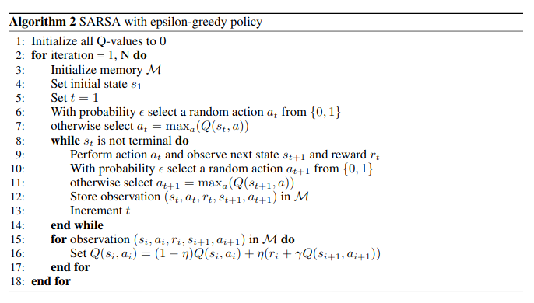
Appendix F
(Vu and Tran, 2020): Use of a backward update at the end of an episode instead of immediate updates at each step:
Reverse updates evaluate more influential information to be evaluated first.
Link to Vu and Tran code

